Slide 1
Data Analytics Lesson 5 Harvesting Data
Jeffrey Strickland, Ph.D.

Slide 2

What is Required by Data Analytics?
Integrate
Analyze
Visualize
V1 | V2 | V3 | V4
1 | 14.23 | 1.71 | 2.43
1 | 13.20 | 1.78 | 2.14
1 | 13.16 | 2.36 | 2.67
1 | 14.37 | 1.95 | 2.50
1 | 13.24 | 2.59 | 2.87

Slide 3
Data Sources
Government
National
Municipal
Agency
Private Companies
Restricted
For Fee
Public Domain
GitHub
CRAN
Social Media
Twitter
Facebook

Slide 4
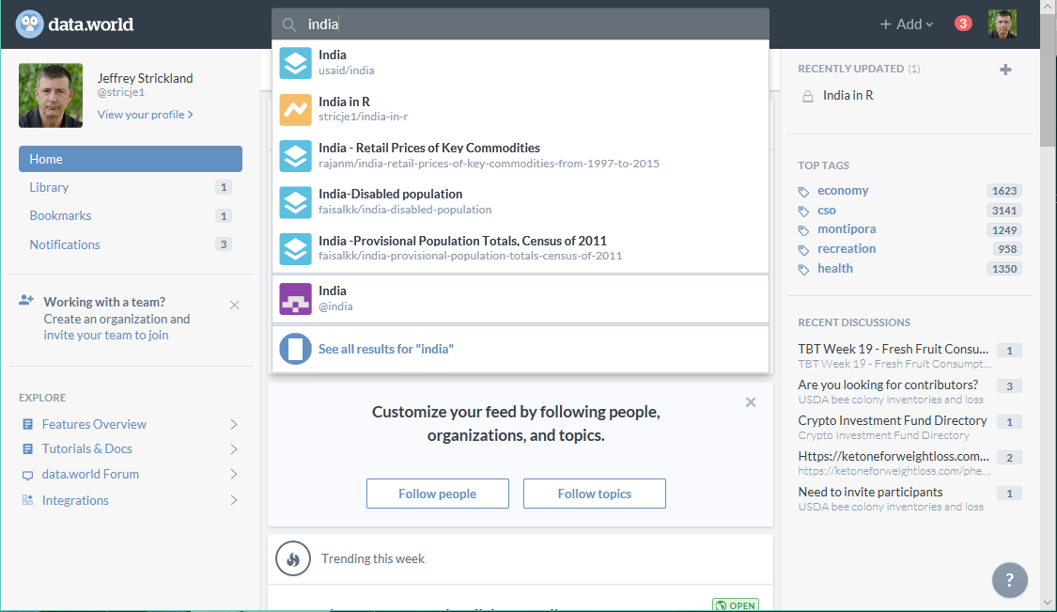
Data.world

Slide 5
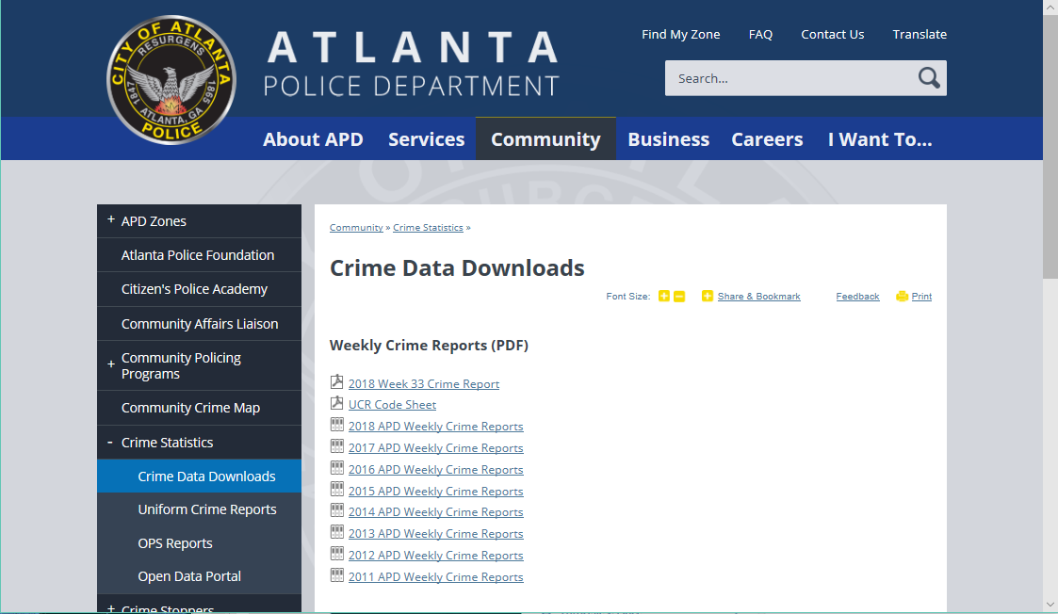
Atlanta Police Department

Slide 6
data(diamonds) # Bundled with ggplot2
data(TitanicSurvival) # Bundled with carData
radiant.data package
radiant.data_window() opens a Radiant window in R Studio
radiant.data() opens a Radiant window in your web browser

Slide 7
ggplot2::Diamonds
Prices of 50,000 round cut diamonds
Description = A dataset containing the prices and other attributes of almost 54,000 diamonds. The variables are as follows:
Usage = diamonds
Format = A data frame with 53940 rows and 10 variables:
price = price in US dollars (\$326–\$18,823)
carat = weight of the diamond (0.2–5.01)
cut = quality of the cut (Fair, Good, Very Good, Premium, Ideal)
color = diamond colour, from J (worst) to D (best)
clarity = a measurement of how clear the diamond is (I1 (worst), SI2, SI1, VS2, VS1, VVS2, VVS1, IF (best))
x = length in mm (0–10.74)
y = width in mm (0–58.9)
z = depth in mm (0–31.8)
depth = total depth percentage = z / mean(x, y) = 2 * z / (x + y) (43–79)
table = width of top of diamond relative to widest point (43–95)

Slide 8
carData::TitanicSurvival
Survival of Passengers on the Titanic
Description = Information on the survival status, sex, age, and passenger class of 1309 passengers in the Titanic disaster of 1912.
Usage = TitanicSurvival
Format = A data frame with 1309 observations on the following 4 variables.
survived = no or yes.
sex = female or male
age = in years (and for some children, fractions of a year); age is missing for 263 of the passengers.
passengerClass = 1st, 2nd, or 3rd class.

Slide 9
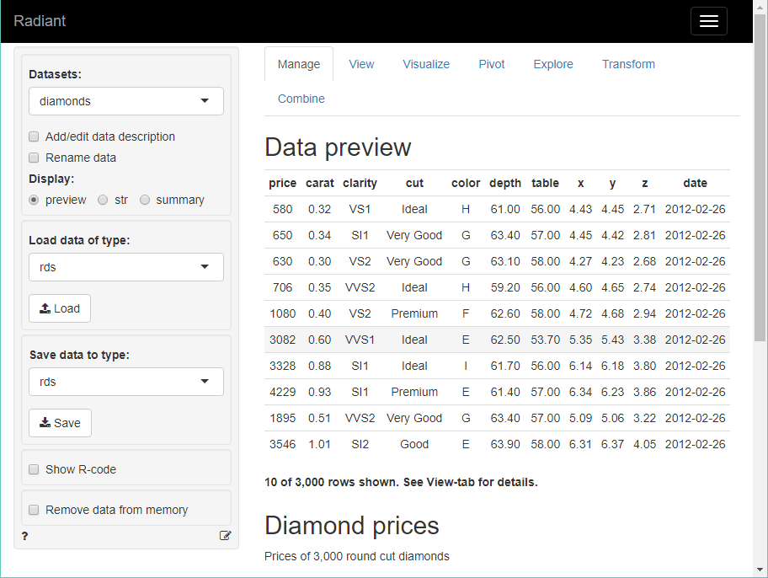
radiant.data
radiant.data_window
radiant.data_viewer
radiant.data()
Radiant is an open-source platform-independent browser-based interface for business analytics in R.
Can be run locally or on a server. Radiant was developed by Vincent Nijs.

Slide 10
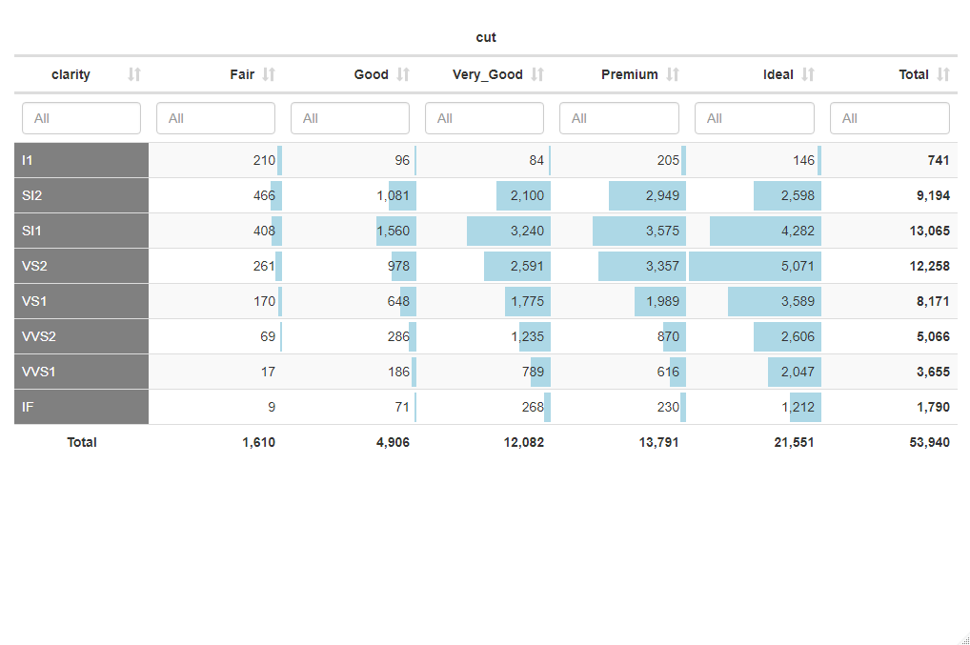
dtab.pivotr: Make an interactive pivot table
radiant.data::dtab.pivotr
pivotr(diamonds, cvars = c("cut","clarity")) %>% dtab(format = "color_bar")

Slide 11
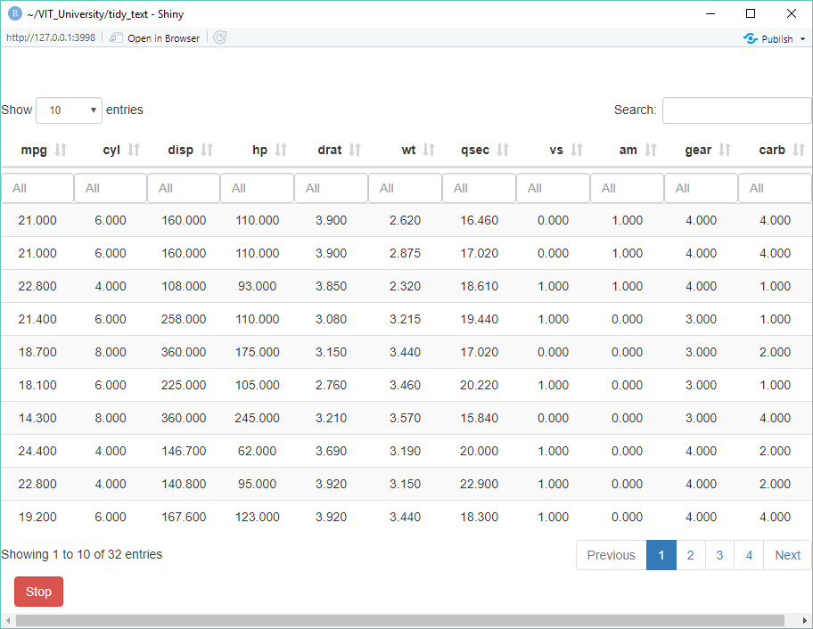
view_data: View data in a shiny-app
view_data(mtcars)

Slide 12
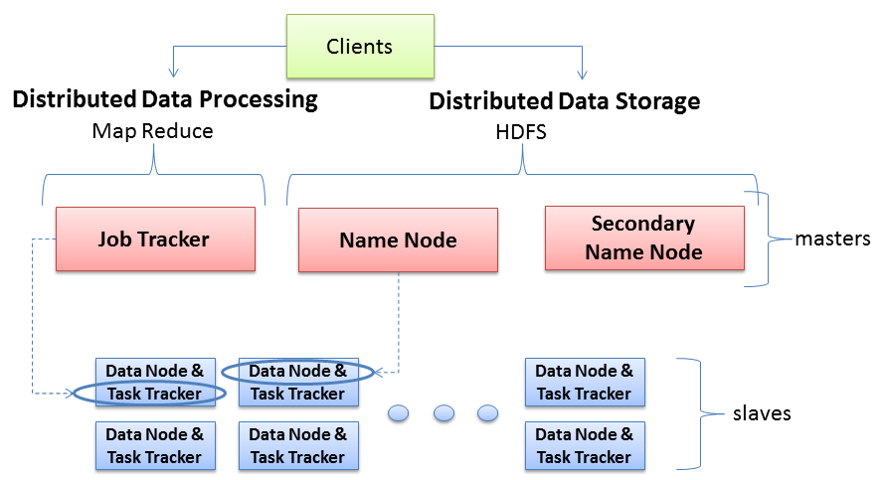
Hadoop Server Roles
NameNode stores MetaData (No of Blocks, On Which Rack which DataNode the data is stored and other details) about the data being stored in DataNodes whereas the DataNode stores the actual Data.
Secondary NN contains the name space image, edit log files' back up for past one hour (configurable). And its work is to merge latest Name Node NameSpaceImage and edit logs files to upload back to Name Node as replacement of the old one
Technical Sense: JobTracker is a master which creates and runs the job. JobTracker which can run on the NameNode allocates the job to TaskTrackers which run on DataNodes; TaskTrackers run the tasks and report the status of task to JobTracker.
two key functional pieces
Oversees and coordinates the parallel processing of data
Oversees and coordinates the data storage function (HDFS)
Physical Sense: The JobTracker runs on MasterNode aka NameNode whereas TaskTrackers run on DataNodes.

Slide 13
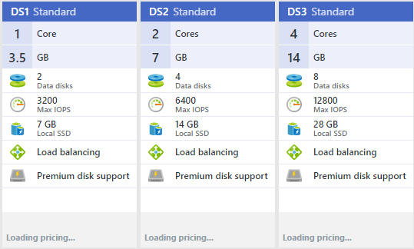
Virtual Machine Configuration
At least 2 Cores
At least 6400 Input/Output Operations Per Second (IOPS)
At least 4 GB
At leasr 4 Data Disks

Slide 14
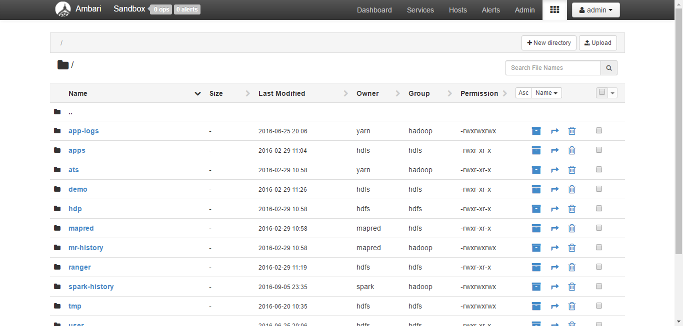
Hadoop Distributed File System (HDFS)

Slide 15
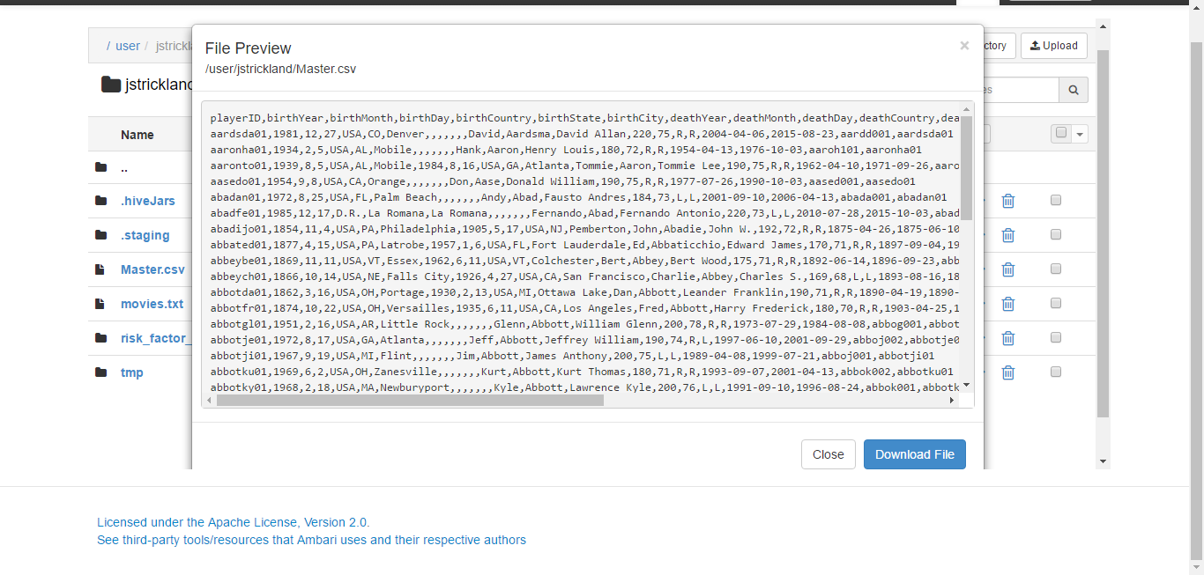
/user/jstrickland/Master.csv

Slide 16
Contact Information
E-mail: jeff@humalytica.com
LinkedIn: https://www.linkedin.com/in/jeffreystrickland
Web site: www.humalytica.com
Skype: jeffrey.strickland2

